Slide 1
Web Design
Creativity is intelligence having fun

Slide 2

Before we begin..
Any time you see somewhere it is really important to remember that part.
They are generally ‘must know’ and easy to remember.
If you forget everything else from a lesson and only remember the top tips, you should be fine!

Slide 3
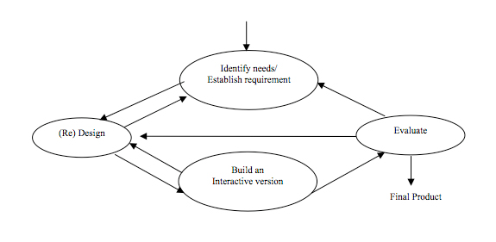
What is web design?
The client is at the heart of everything you do

Slide 4
Web evolves, so must you
http://www.evolutionoftheweb.com
http://99designs.com/designer-blog/2014/02/25/5-graphic-design-trends-watch-2014/
http://www.forbes.com/sites/ilyapozin/2014/05/15/let-it-go-say-farewell-to-these-5-web-design-trends/
http://justcreative.com/2014/04/28/hottest-web-design-trends-2014/

Slide 5
Follow the trends
SmashingMagazine
E-Web Design
http://www.rasmussen.edu/degrees/design/blog/web-design-blogs-2014/

Slide 6
5 tags
Every website must have these 5 tags
Learn these for next week
DOCTYPE
Html
Head
Title
Body

Slide 7
A quick note on syntax
All tags must open and close
They can do this in one of 2 ways:
<tag>Some stuff</tag> (very common)
<tag /> (uncommon)
You will learn when to use these as we go
The only exception to this is the DOCTYPE which never closes.

Slide 8
<!DOCTYPE html>
The DOCTYPE is the first thing on the page
It tells the browser what version of HTML you are using
Helps hugely with Cross Browser Compatability (Which we will look at later)

Slide 9
<html>
Definition and Usage
The <html> tag tells the browser that this is an HTML document.
The <html> tag represents the root of an HTML document.
The <html> tag is the container for all other HTML elements (except for the <!DOCTYPE> tag).

Slide 10
<head>
The head tag is the first nested tag
A nested tag is a tag inside another
The head tag does the thinking for the document
Any external content that needs to be loaded in generally goes in here

Slide 11
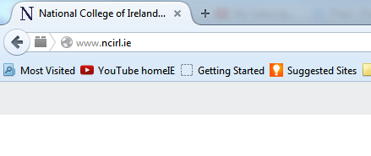
<title>
The title tag is nested inside the head tag
It tells the document/browser what its title is

Slide 12
<title>
More importantly, the title tag is used for SEO (Search Engine Optimisation)
The title tag gives Google ‘meta’ information about the site, and shows up in search results.

Slide 13
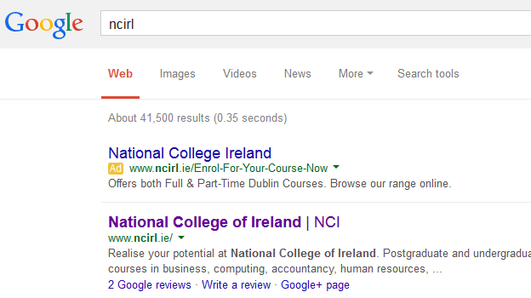
<title>

Slide 14
<body>
The body tag begins when the head tag ends.
The body tag generally contains any content we want displayed on the page
This includes images, text, video etc
The <html> tag will close after the body

Slide 15
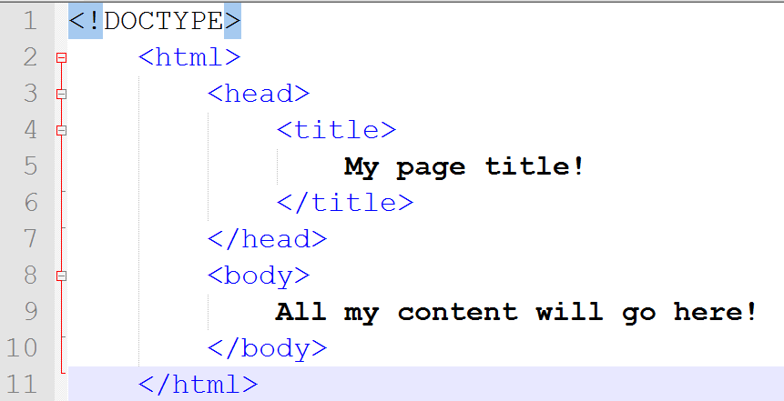

Slide 16
Hands on
All you need is a plain text editor and a browser
Notepad++ and Google Chrome are easiest

Slide 17
Cross Browser Compatability
Browsers tend to interpret code in slightly different ways
We use strictly written code to combat this
A set of rules for web code are called ‘code standards’
Think of it like this:
Eats, shoots and leaves
If it can be misinterpreted, it will be!

Slide 18
Cross Browser Compatability
Massive problem in the 90’s/early 2000’s
Sites would have to be written a different way for every browser
Hugely costly
Greater expertise needed by developers
Not future proof
INTERNET EXPLORER IS THE DEVIL

Slide 19
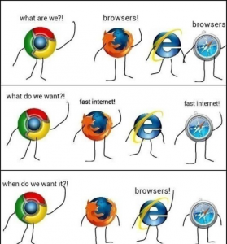

Slide 20
Summary
5 tags to learn
All tags open and close (bar the DOCTYPE)
Writing good ‘web standard’ code saves time later
Internet explorer is the devil

